Slide 1

Introduction to …
(tiny) Embedded Systems

Slide 2

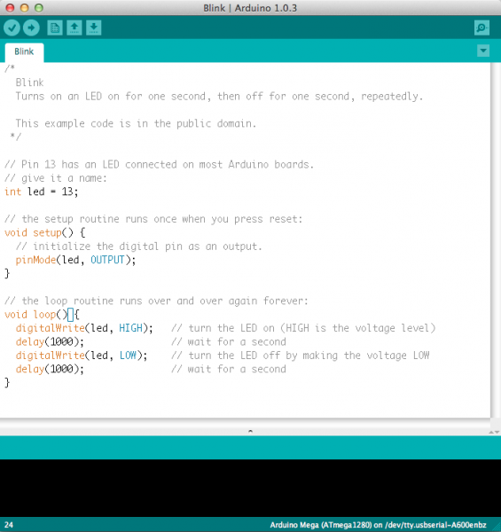

Introdução ao Arduino
Arduino is an open-source platform used for building electronic projects.
Arduino consists of a programmable board (often referred to as the microcontroller) and a software, or IDE (Integrated Development Environment) that runs on the computer, used to write and load code from the computer to the board.

Slide 3
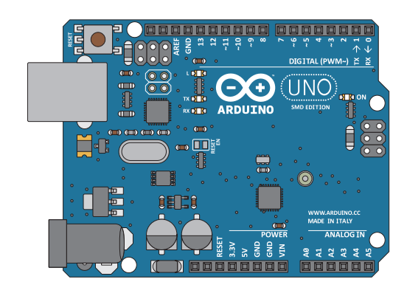




Arduino Microcontroller
A computer for the physical world.
Able to read INPUTS – light on a sensor, a finger on a button, or a Twitter message.
Turn it into OUTPUTS – activating a motor, turning on an LED, publishing something online.
Tell your Arduino what to do using the Arduino programming language.
www.arduino.cc
Uses information from INPUTS to control various OUTPUTS.

Slide 4

Why ?

Slide 5
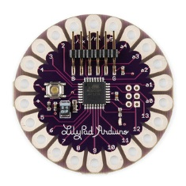
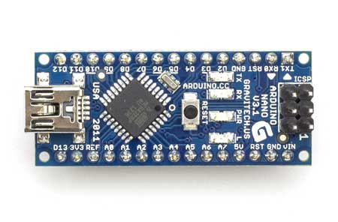
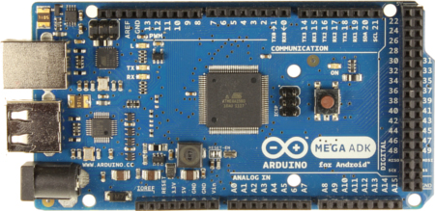
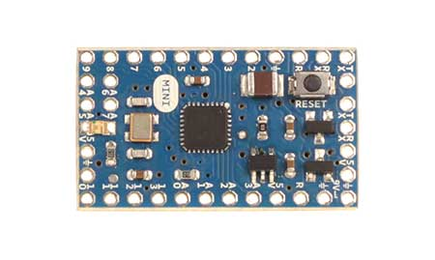
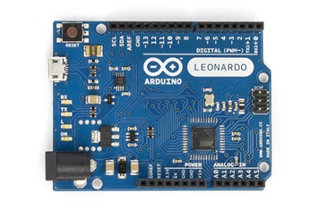
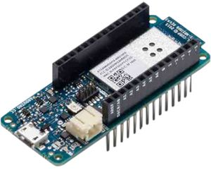
Types of Arduino Boards
Arduino Nano
Arduino LilyPad
Arduino Mega
Arduino Mini
Arduino Uno
Arduino Leonardo
MKR1000 WIFI

Slide 6
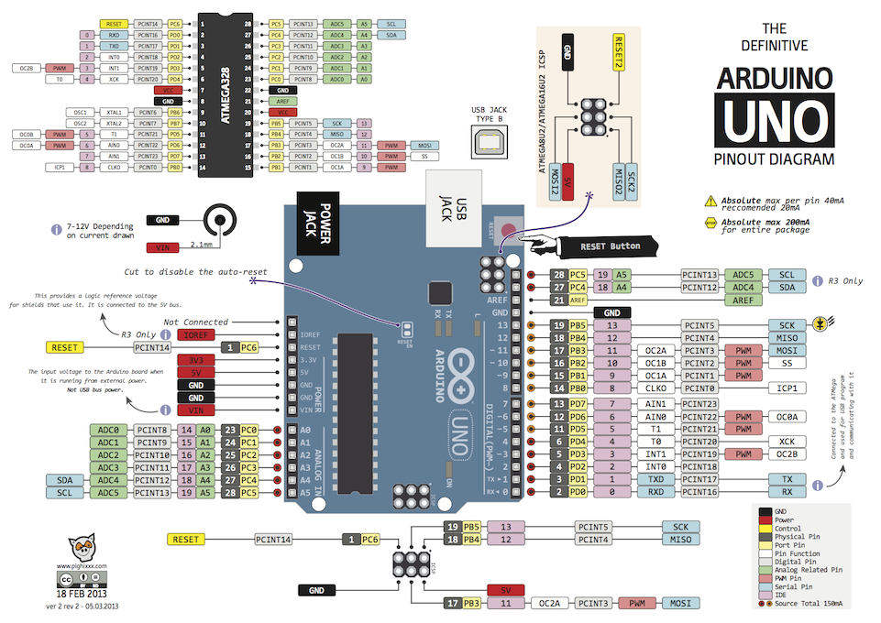

Slide 7
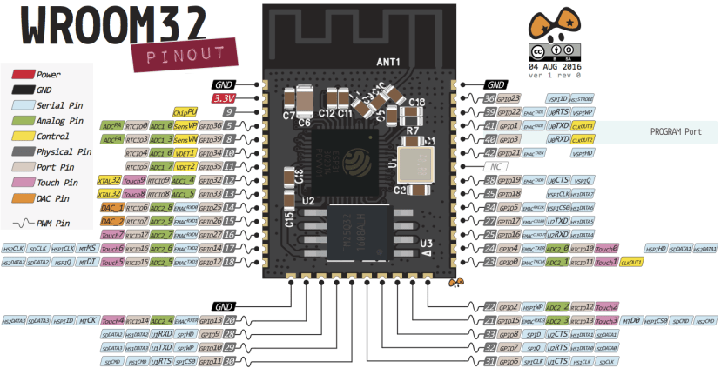
Arduino - Módulos
Sensors
Buttons
Lights
…

Slide 8
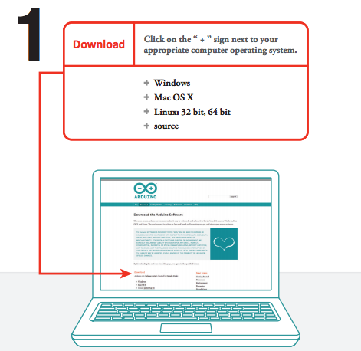
Download Arduino IDE (Integrated Development Environment)
arduino.cc

Slide 9
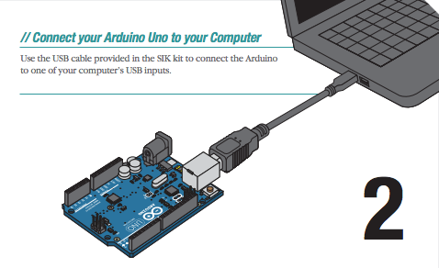
Connect to your Computer

Slide 10
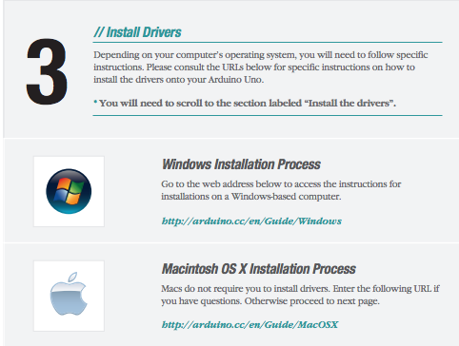
Install Arduino Drivers

Slide 11
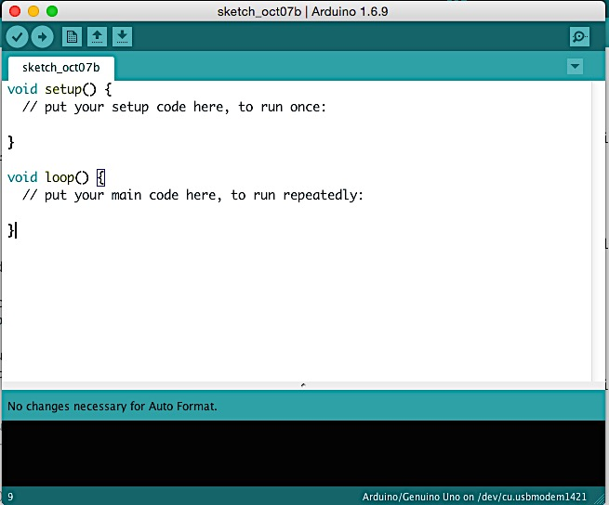
OPEN arduino ide

Slide 12
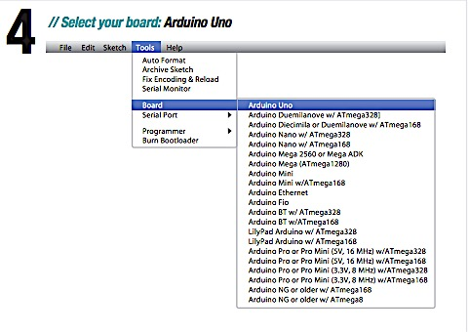
Select your Board

Slide 13
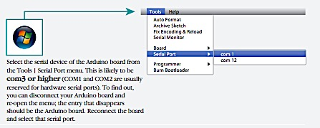
Select Serial Device (Windows)

Slide 14
KNOW the Arduino GUI
Verify: Compiles and approves your code. Will catch errors in syntax.

Slide 15
KNOW the Arduino GUI
Upload: Sends your code to the board. When you click it you should see lights on your board blink rapidly.

Slide 16
KNOW the Arduino GUI
New: Opens up a new code window tab.

Slide 17
KNOW the Arduino GUI
Open: Open an existing sketch, which is where you write your code.

Slide 18
KNOW the Arduino GUI
Save: Saves the currently open sketch.

Slide 19
KNOW the Arduino GUI
Serial Monitor: Opens a window that displays any serial info the board is transmitting. Very useful for debugging.
What is Serial?
Process of sending data one bit (0 or 1) at a time.

Slide 20
KNOW the Arduino GUI
Sketch Name: Name of the sketch you are currently working on.

Slide 21
KNOW the Arduino GUI
Code Area: Area where you compose the code for your sketch.

Slide 22
KNOW the Arduino GUI
Message Area: Where the IDE tells you if there were any errors in your code.

Slide 23
Code structure
void setup()
This function is only executed once and is normally used to perform the initialization of variables, the initialization of libraries, the definition of pins (as input or output), the beginning of serial communication, among others. This function is only executed again when resetting or switching the Arduino development board off and on again.
void loop()
This function makes a successive "loop" (as the name indicates), that is, all the commands inside this function are successively repeated, which may allow the successive reading of ports, the successive reading of parameters from external sensors and act according to the established conditions.

Slide 24
Code variables
Constants
true - indicates a true logical value
false - indicates a false value
HIGH - indicates that a port is activated, i.e., it is at 5V.
LOW - indicates that a port is off, i.e., it is at 0V.
INPUT - indicates that a port will be inputting data.
OUTPUT - indicates that a port will be outputting data.
Digital Inputs
Logic level "1" from 3v to 5v
Logic level "0" from 0v to 0.5v
Digital Outputs
Logic level "1" equals 5v
Logic level "0" equals 0v
int state = digitalRead(pin)
digitalWrite(pin, state)

Slide 25
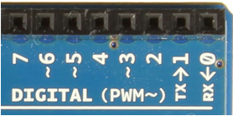
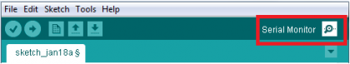
Example: Arduino – Serial Communication
It is possible to send information from the Arduino to the PC (or other devices) using the IDE (or other terminal program would be, e.g. Terminal1.9b), in order to check if the program is running as expected (e.g. debug), and thus detect and eliminate programming errors, or perform any other kind of communication/interaction with the machine.
Arduino boards have at least one serial port (UART / USART), called Serial.
Function | Meaning
available() | Gets the number of bytes available for reading from the serial port.
begin() | Sets the data rate in baud for serial data transmission
end() | Disables serial communication, allowing the TX and RX pins (0 and 1) to be used for general input and output signals.
print() | Prints data on the serial port in human-readable format (ASCII text)
println() | Same as print(), but adding a carriage return character (ASCII 13) and a newline character (ASCII 10) at the end of the string.
read() | Read data from the serial port.
readBytes() | Reads characters from the serial port into a buffer until a certain amount of characters have been read.
write() | Writes binary data to the serial port
int num = 0;
void setup()
{
Serial.begin(9600); // bps
Serial.println(“Setup OK");
}
void loop()
{
Serial.print("Valor: ");
Serial.println(num);
delay(500);
num++;
}

Slide 26
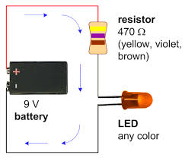
What is a Circuit?
Electricity running in a loop with a starting point and ending point – and a number of components in between.
Can include resistors, diodes, inductors, sensors of all shapes and sizes, motors, and hundreds of thousands of other components.
OHM’S LAW
Voltage = Current x Resistance
V = I*R
Voltage is measured in VOLTS (V)
Current is measured in AMPERES (A)
Resistance is measured in OHMS (Ω)
The LED above needs 20 mA (milliamps) of current. What size resistor should you use?
Notes:
Answer: 450 ohms

Slide 27
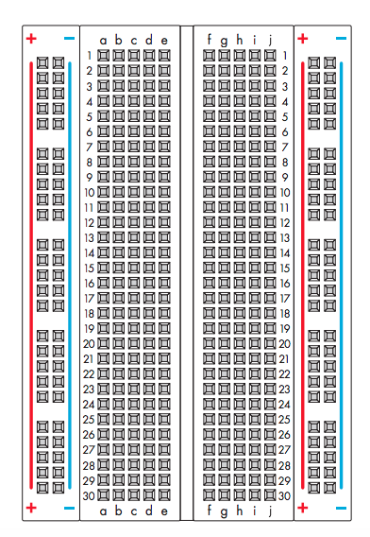
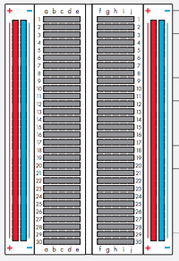
Breadboard
How it looks
How it’s connected
Connect power to the + vertical columns
Connect ground down the - vertical columns
Components placed along horizontal rows will be connected when power is running.
This line divides the board in half

Slide 28
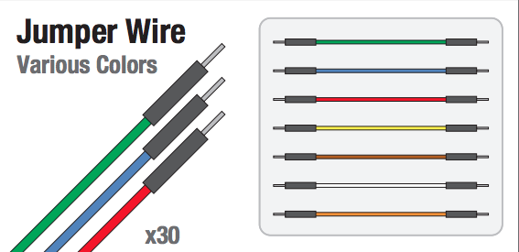
Jumper Wire

Slide 29
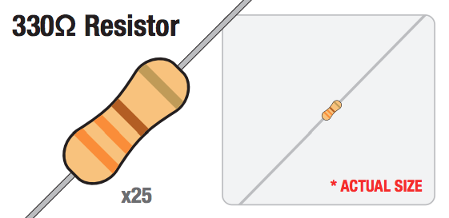
330 Ω Resistor

Slide 30
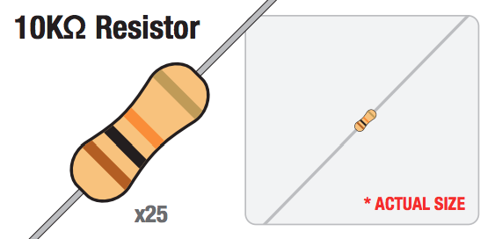
10 kΩ Resistor

Slide 31
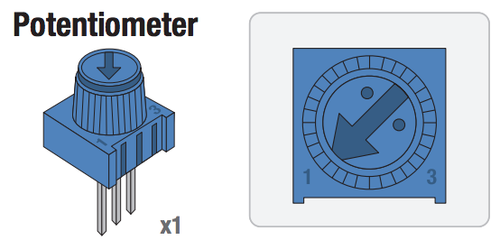
Potentiometer

Slide 32
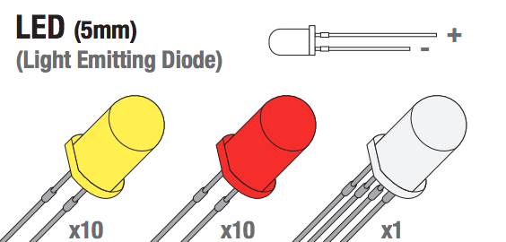
Light Emitting Diode (LED)

Slide 33
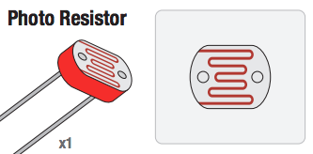
Photo Resistor

Slide 34
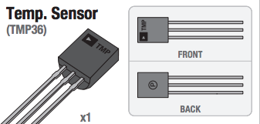
Temperature Sensor

Slide 35
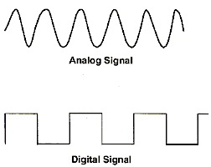
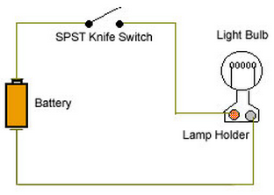
Analog vs digital signals
5V
0V
5V
0V
Notes:
An analog signal is a signal that can have a huge range of values. These values are continuous, like a sine wave.
If you’re using a microcontroller that has a “logic level” of 5V, it has a base voltage of 0 (ground) and a maximum voltage of 5V. With this logic level, an analog signal can vary anywhere between these two levels.
Most things we deal with in the real world are analog. Consider a light sensor that is used to measure the intensity of sunlight. When configured in a “voltage divider circuit” (more on this later), the amount of sunlight that shines on the light sensor will change the voltage across the light resistor. No light might correspond to a 0V signal. Partial shade might correspond to a 2.5 V signal, and full light might correspond to a 5V signal. And there are many many values in between. It’s a CONTINUOUS SIGNAL.
Digital signals are different. They have one of two values – either HIGH or LOW. The way we often seen this represented is as a 1 or a 0. 1 representing HIGH or ON, and 0 representing LOW or OFF. So if we’re talking about the same 5V microcontroller that we were before, when we get a voltage close to 5, it corresponds to a 1, and when we get a voltage close to 0 it corresponds to a 0. An example in real life is just a simple light switch. When we close the switch, electricity from the battery will flow through and turn the light bulb on. A microcontroller would measure that as a 1 because it’s seeing the full voltage. If the switch is open it would register that as a 0.

Slide 36
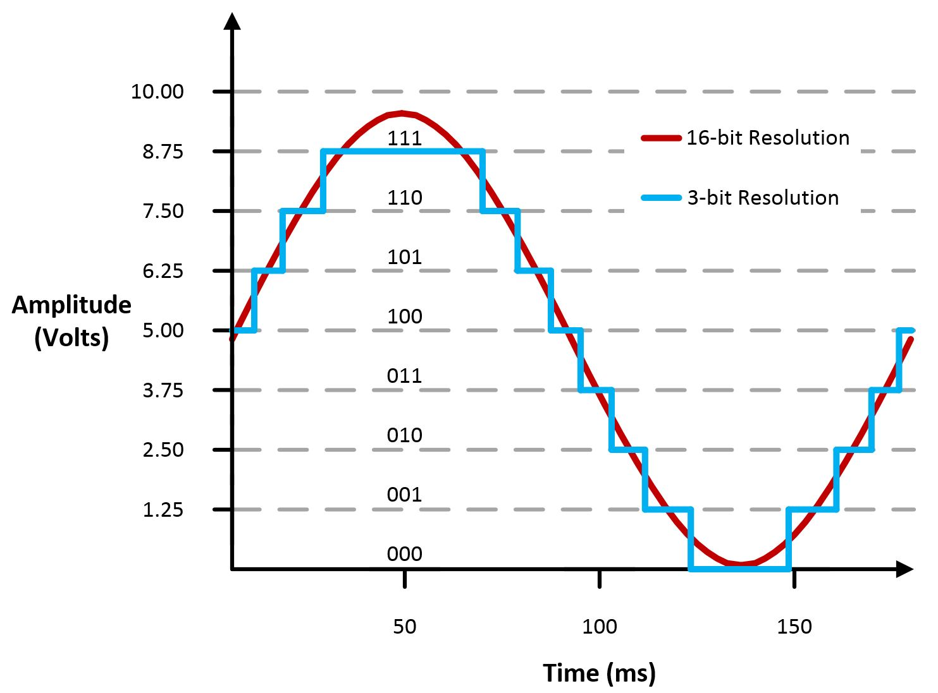
Analog to digital conversion
Need to convert analog signals to digital for processing.
Digital signal depends on the resolution of the analog-to-digital converter (ADC).
A 10-bit system will have 1,024 points of resolution.
2¹⁰ = 1,024
Why the number 2?
Because there are two options in a binary system (0 & 1).
Notes:
Since most everything in the world is analog, how do we convert between the two? How do we take an analog signal and convert it to a digital signal? That’s done with analog-to-digital converters.
Let’s say we have that analog signal from the light sensor coming into our system, which ranges from 0V – 5V. So now we need to convert that to a digital signal because that’s what our Arduino needs in order to process it. What our digital signal looks like is going to depend on the resolution of the analog to digital converter (ADC) in our system.
Basically our system’s resolution is based on the number of bits. If we have a 10 bit ADC, that’s going to be 2^10 bits because 2 is the number of options we have (0 or 1). That equals 1,024. So a 10-bit system is going to have 1024 bits of resolution. Generally we see 0 to 1023 because 0 registers as 0V. This is really important because when we use the “serial monitor” in Arduino to read the voltage from the analog input pins, we’ll read values between 0 and 1,023. So keep this in the back of your head as we move forward.
So - a 10 bit system will break our analog signal into 10 different horizontal steps. As the figure on the slide shows, a 3-bit system will break the analog signal into 3 bits, which we can easily see. With a 16-bit system, it’s hard to see the different steps, and the signal looks a whole lot smoother.

Slide 37
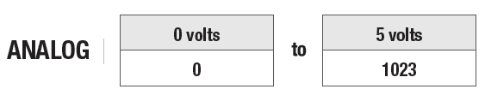
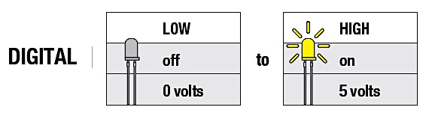
Analog to digital conversion
Arduino translates an analog input voltage into a number that ranges from 0 - 1,023.
Digital voltages are translated into a number that ranges from 0 – 255.
0
255

Slide 38
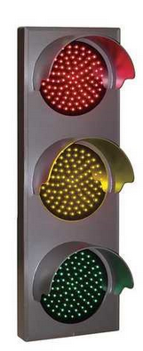
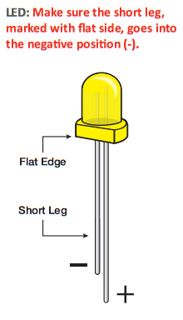
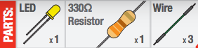
Circuit #1: Blinking an LED
LEDs (light emitting diodes) are small, powerful lights used in many different applications.
We’re going to learn how to blink an LED on and off.

Slide 39
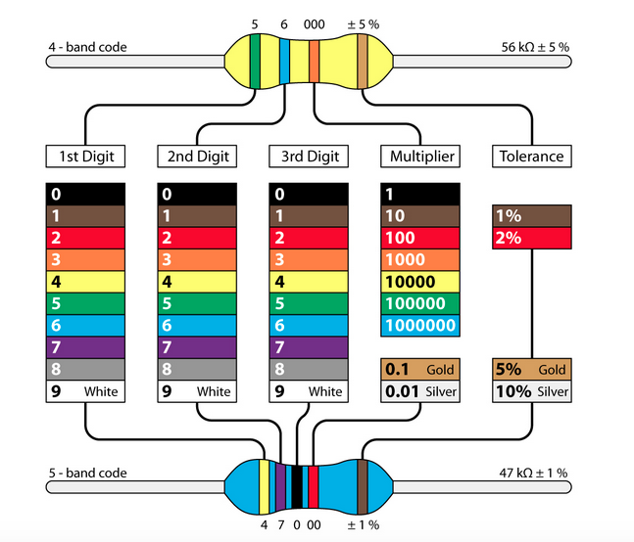
Resistor Color Code

Slide 40
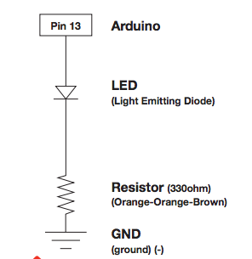
Circuit Schematic
Pin 13 is a digital pin and can be used as an output or an input. Here we will use it to output power to the LED.
Pin 13 will be connected to the positive lead on the LED.
The negative lead on the LED will be connected to one leg of the resistor.
The other leg of the resistor will be connected to ground to complete the circuit.
Note: These components are all in series (one after the other, like beads on a string).

Slide 41
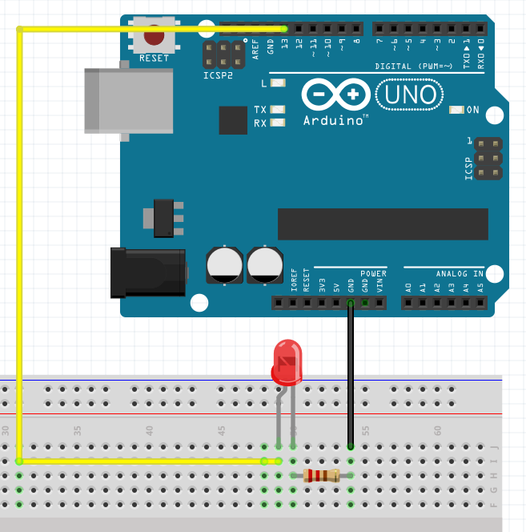
Design it!

Slide 42
Create the Sketch & Code
/*
Blink
Turns on an LED for one second then off for one second, repeatedly.
*/
void setup() {
pinMode(13, OUTPUT);
}
void loop() {
digitalWrite(13, HIGH);
delay(1000);
digitalWrite(13, LOW);
delay(1000);
}
Notes:
Notes:
// Is how you make single-line comments in the sketch.
/* is how you make multi-line comments. Make sure the end of your comment ends with */
Notice the two functions setup() and loop (). All sketches must have these functions, which will run automatically when the sketch is uploaded. The setup() function runs only once when the sketch starts and is used for things you need to do first, or only once. In this case we are setting digital pin 13 to be an output, which means that it will output 0V and 5V (which will turn the LED off and on).
After setup() finishes, the loop() functions runs over and over until you turn off or reset your Arduino. This is where the bulk of your sketch will be. Here, this is where we will write the code to make the LED blink on and off.
Since we have an LED connected to pin 13, if we make the output HIGH, the LED will get voltage and light up. If we make the output LOW, the LED will have no voltage and will turn off. We use the function digitalWrite() to do this. It takes two values – a pin number followed by the word HIGH or LOW.
To make the LED show a blinking pattern, we have to use a delay so the LED stays on and off for a certain amount of time. We use the function delay() which takes one input – milliseconds. So delay(1000) would cause the program to pause for one second.
Experiment:
1. Make the LED blink more rapidly. Then more slowly.
2. Make a blinking pattern like short, short, long.
3. Determine how rapidly the LED has to blink for our eyes to perceive the LED as staying on (not blinking).

Slide 43
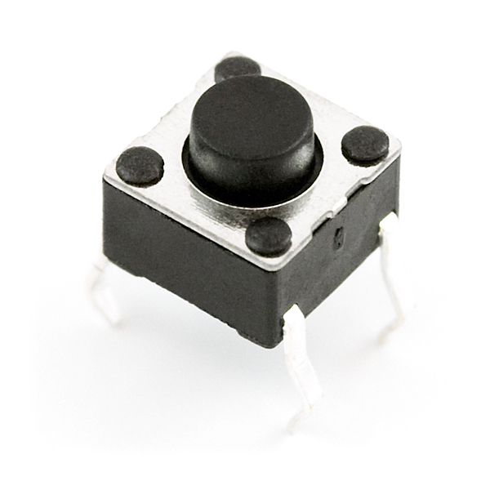
Circuit #2: LED Wave with trigger
Make a circuit where three LEDs turn on in sequence, with a 1-second delay between them, and then turn off equally in sequence.
Tips:
PinMode() function to set the pins as input or output
DigitalWrite() function to set the logic level of the pin.
Delay() function to stop the program.
Arduino Cheat Sheet

Slide 44
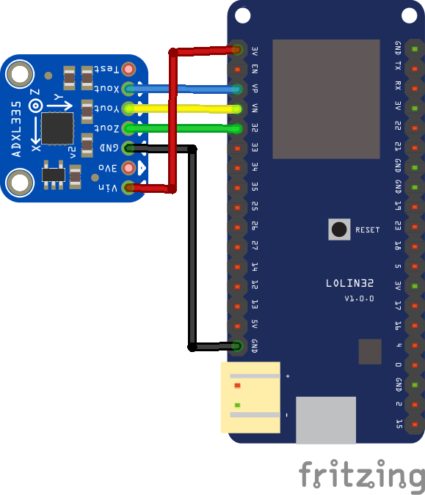
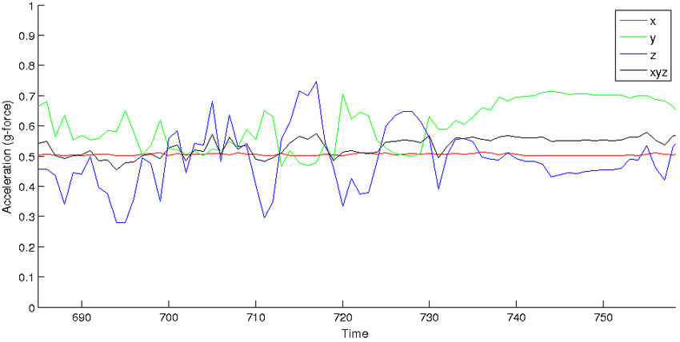
Circuit #3: Motion/Color sensor
Make a circuit with an I2C accelerometer sensor that reads the 3-axis information at 100Hz and turns one led color above a threshold value for each axis.

Slide 45


Circuit #4: MQTT communication
Make a circuit with an I2C accelerometer sensor that reads the 3-axis information at 100Hz and turns one led color above a threshold value for each axis.
For each led change, send a notification using MQTT.

